Slide 1
Trainvasion
By Asia Rollins, Nathan,Angel Martinez,Seth Pairish

Slide 2
Game Description
Single Player, turn-based game, decision making, where the player operates a streetcar. The goal is to get to the final stop (Tappan Street Station) with as many people as possible. Having more people will open routes and opportunities. The stops consist of turn-based battles or events. Players will have to take the streetcar battery power into consideration as well, power is needed to reach the end.

Slide 3
Story
Just a normal day working at Tappan Street Station as a Motorman in Brooklyn. As a Motorman my job is simple, I make multiple stops picking up and dropping people off. Yeah, just me and a good cup of coffee everyday. That’s strange, the streetcar just stopped, are we having a power outage? Mmm… should I go ahead and switch to battery power? Let me get on the comms and see what’s going on. HQ this is streetcar seven, there seems to be an electrical problem. I need permission to switch to battery power. Hello, can anyone hear me? Does anyone know if we’re having a power outage?. Mmm… No answer. Let me call them on my phone. Crap, I pulled a double yesterday and forgot to charge it. Well according to the Streetcar Handbook, if unable to reach HQ I’m able to proceed as needed. Let’s see, battery power is at 100%. Looks like I have plenty of power to return to HQ, if I don’t drain it. Let’s see here, according to the Streetcar Handbook, it’s best to limit the use of lights, doors, and stops. If a stop is needed, it’s best to turn battery power off, to conserve energy. Warning, switching back to battery power might cause delay. Once the green light is on, Motorman can proceed with caution. Well, now the question is should I risk picking people up…
Wait, did you hear that? Sirens? Did you feel that? That wasn't an earthquake, not in Brooklyn? There it is again, WHAT THE HECK! Is that smoke? Something isn’t right, I have to go. I have to get home fast.

Slide 4
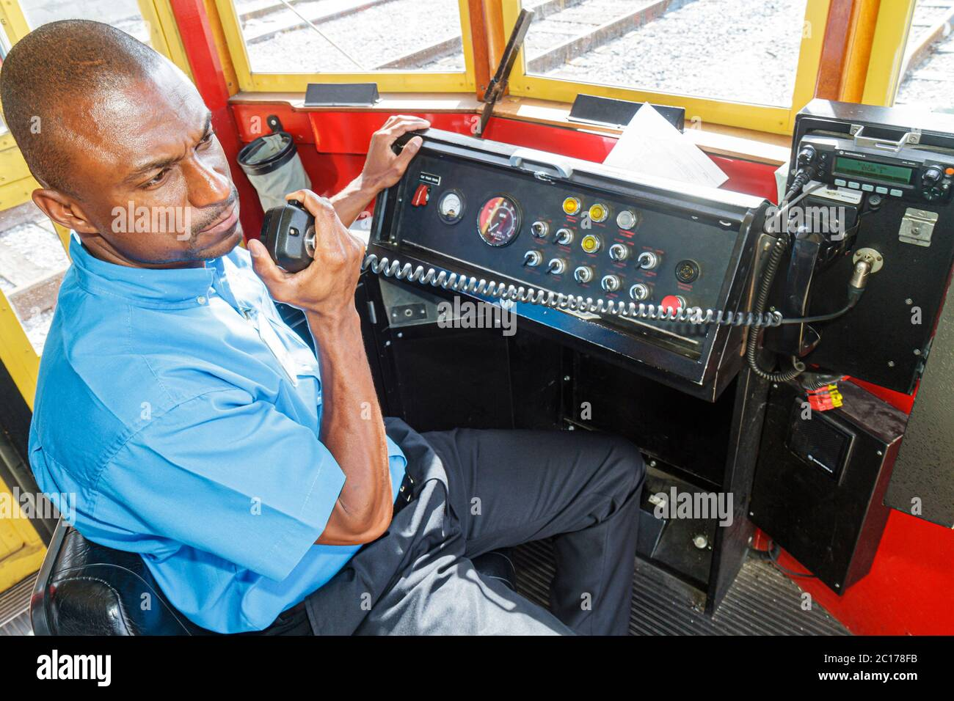
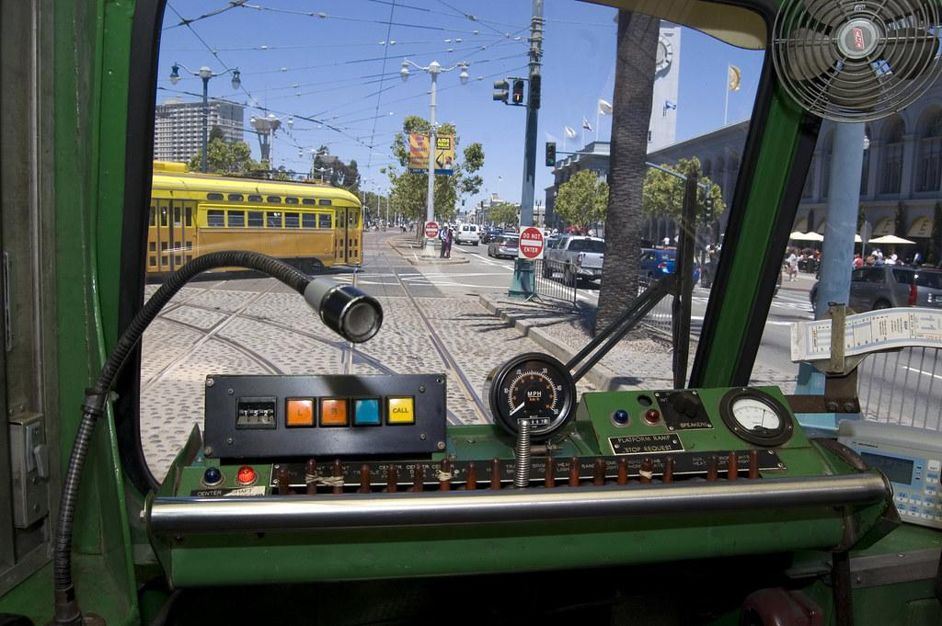
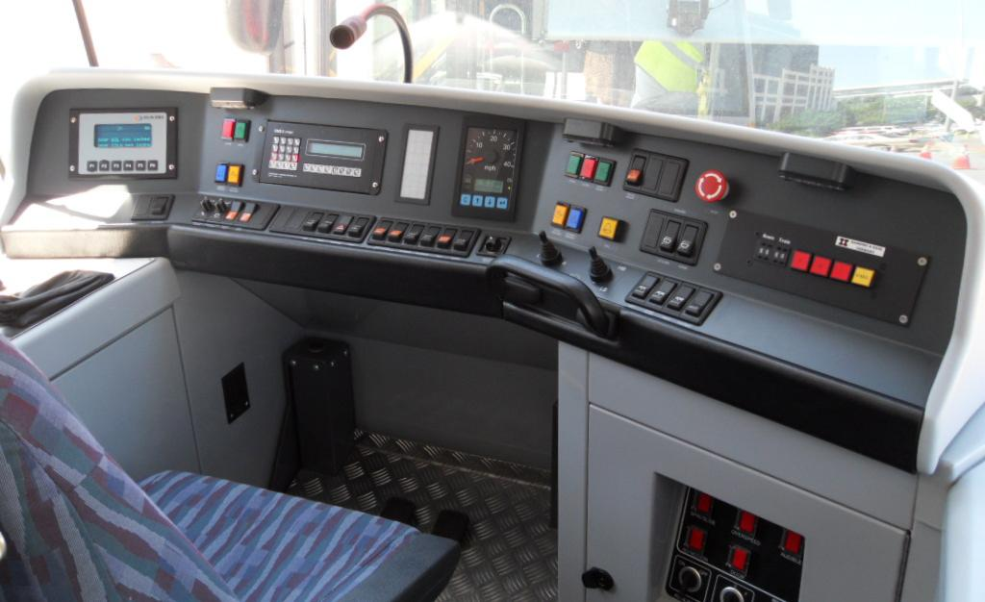
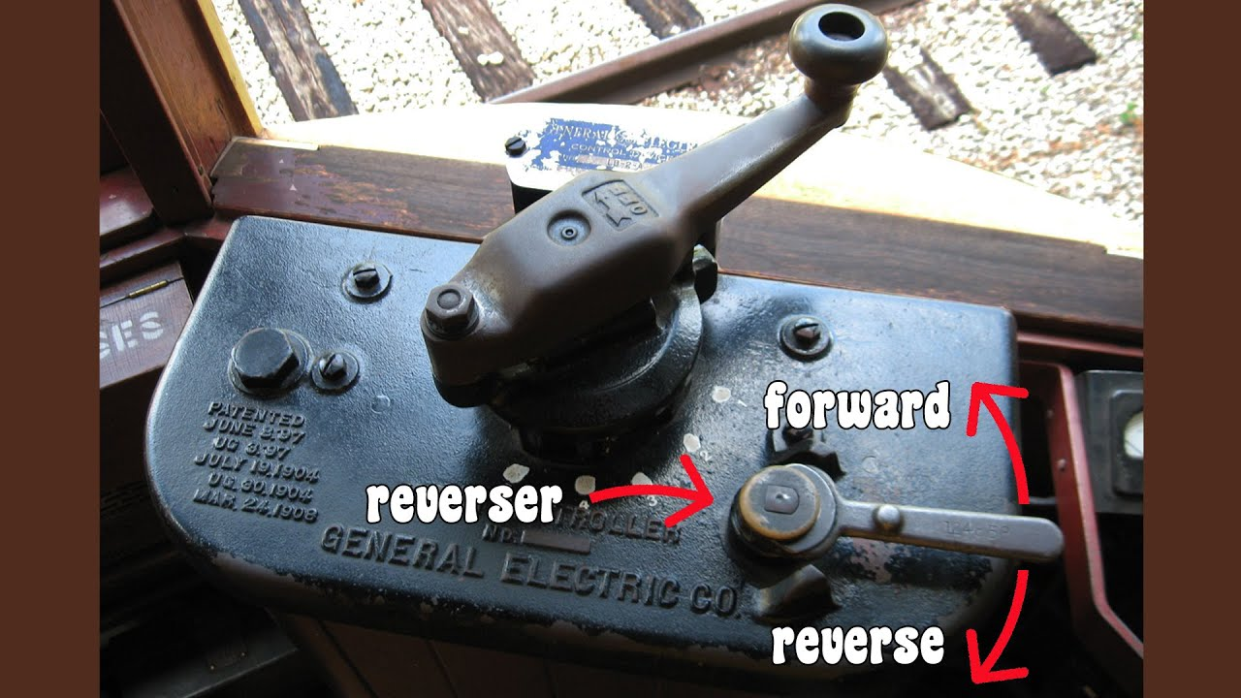
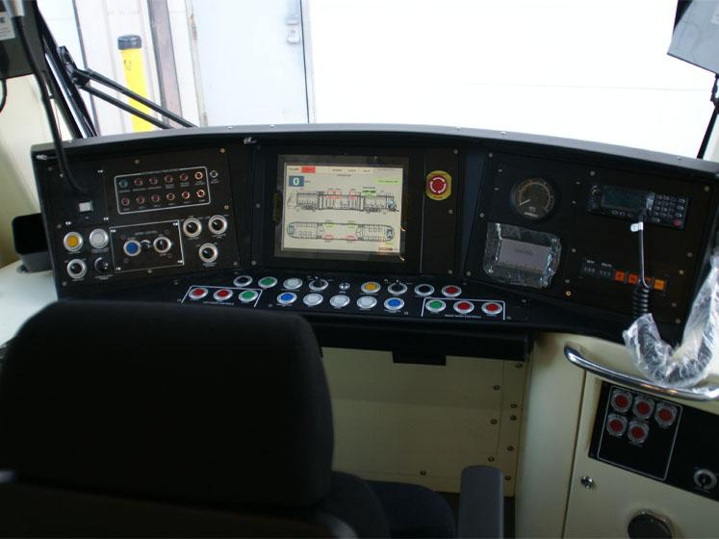
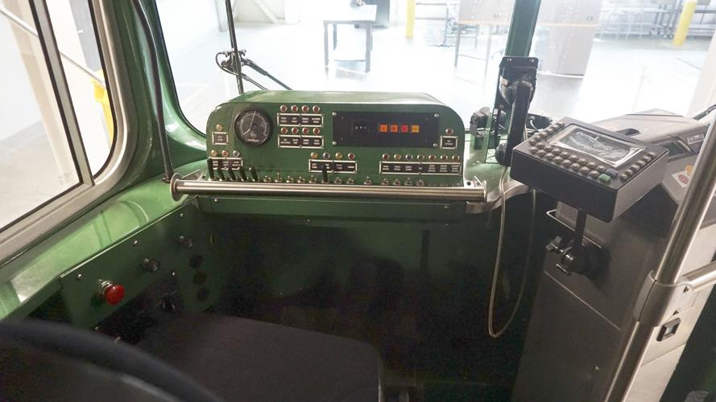
Streetcar

Slide 5
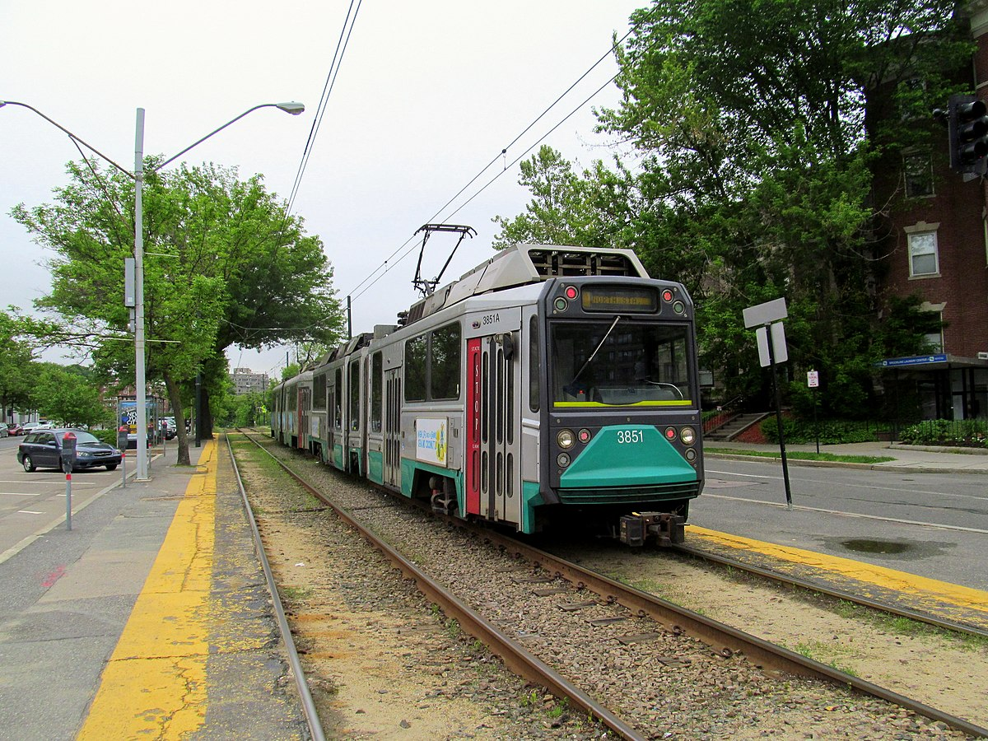
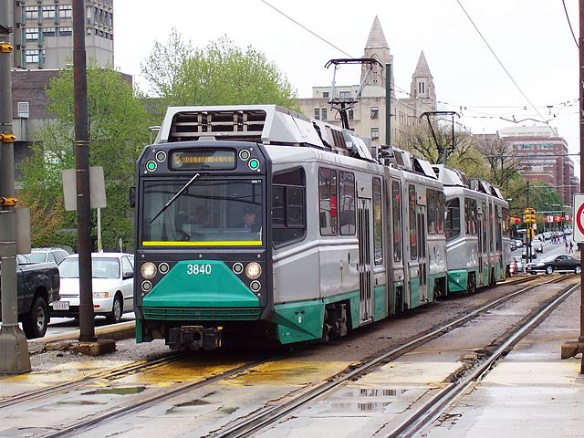
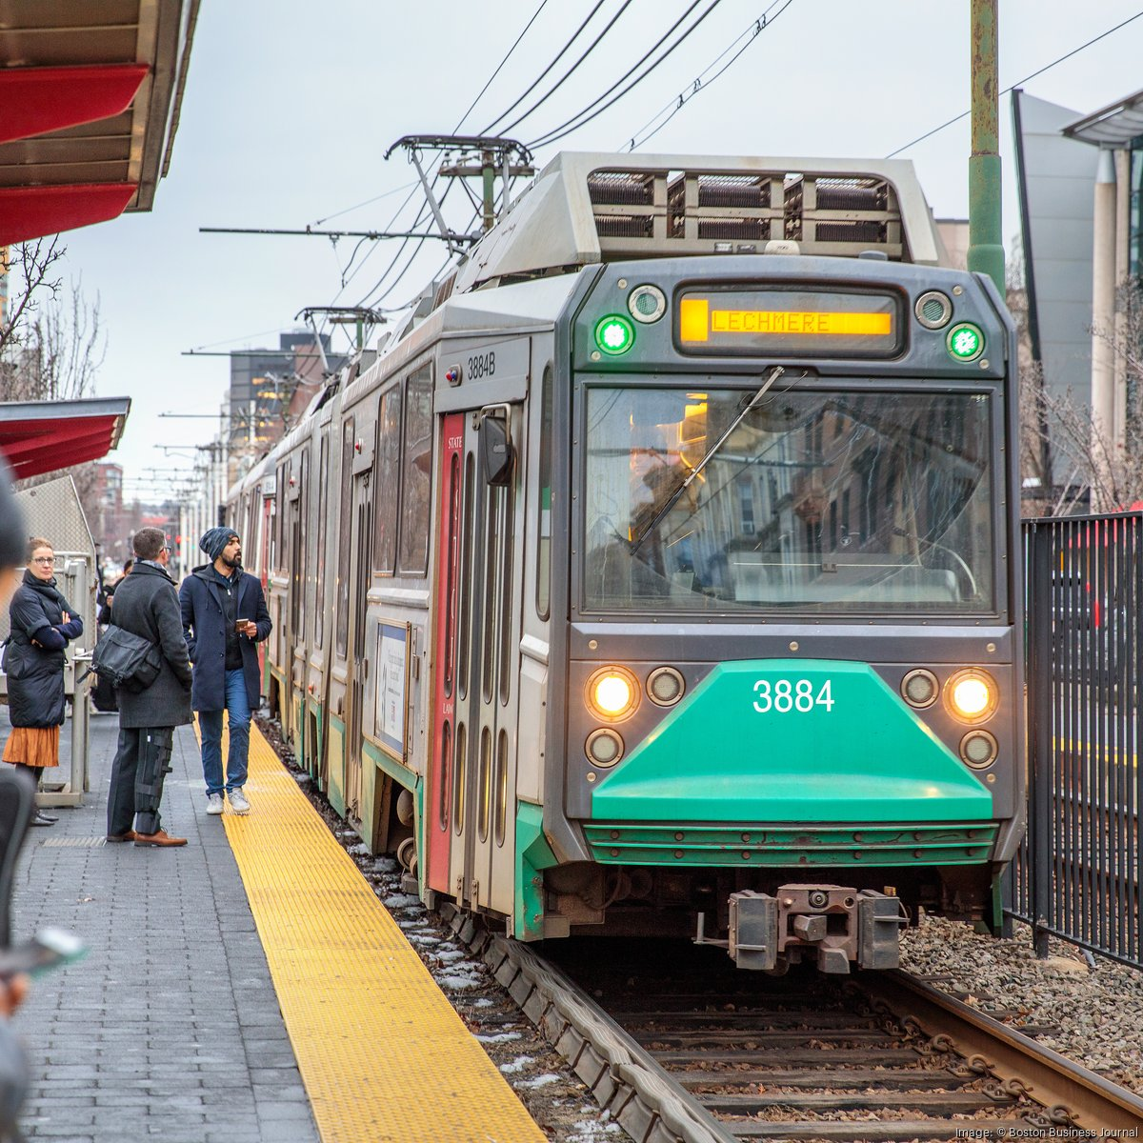
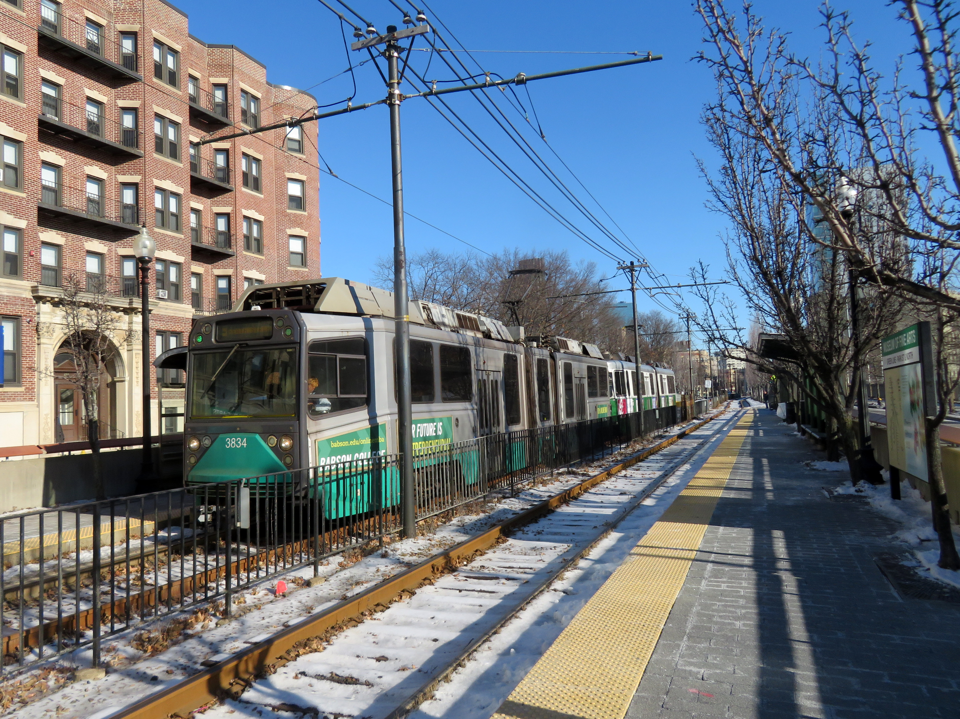
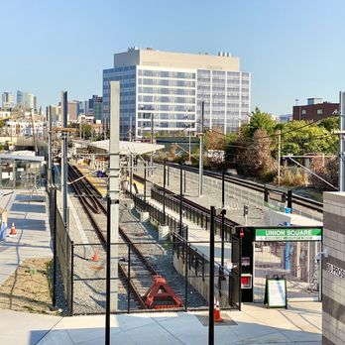
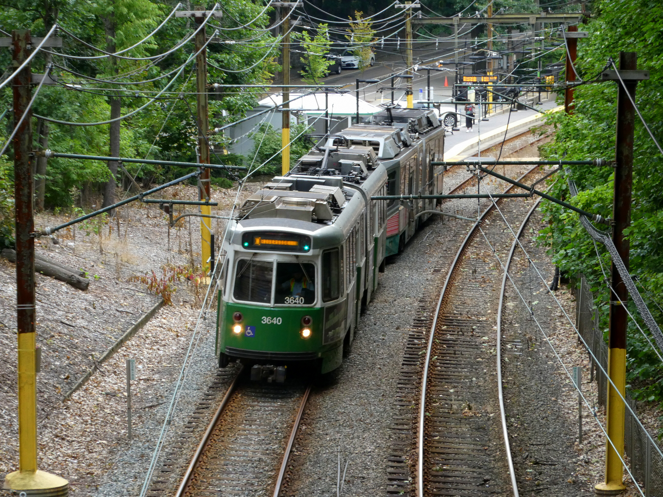
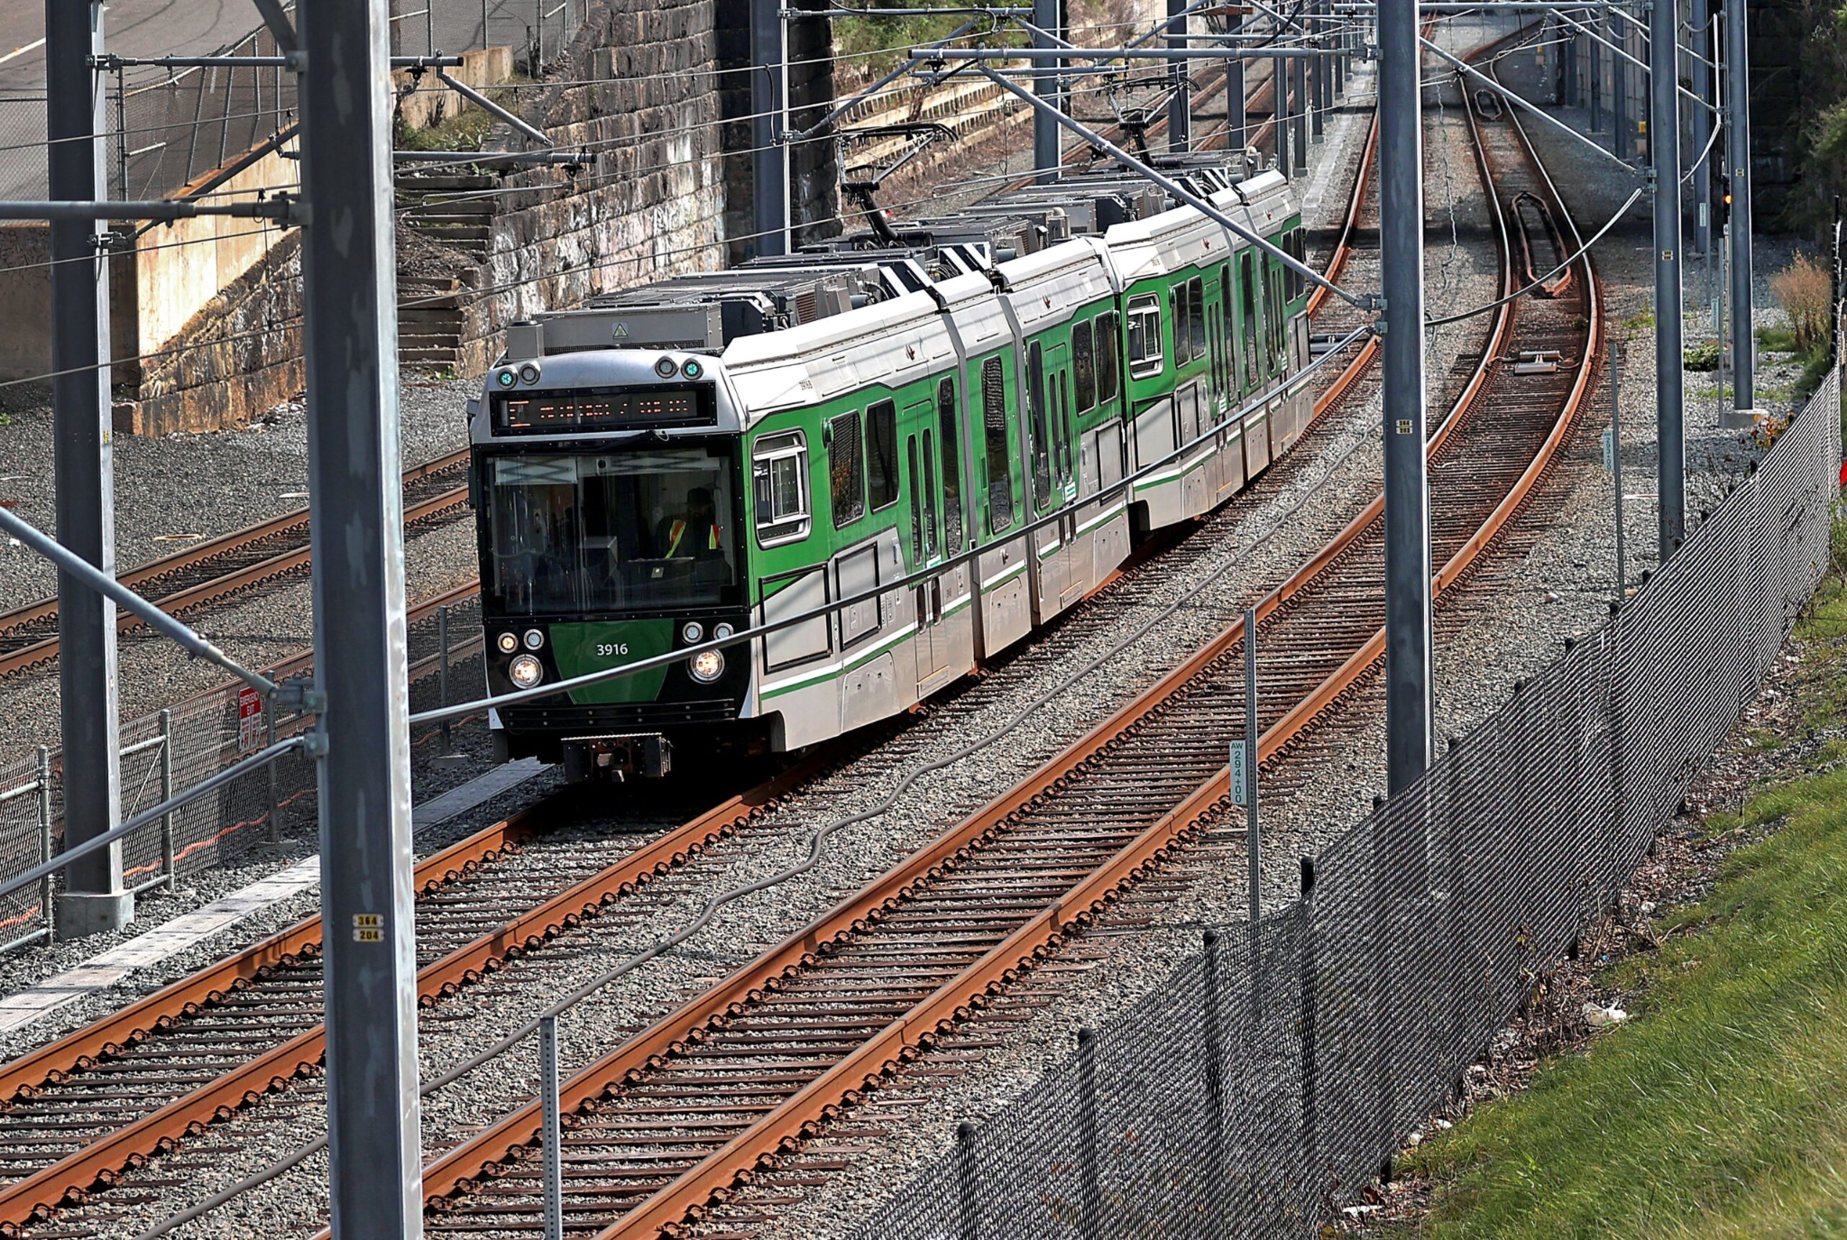
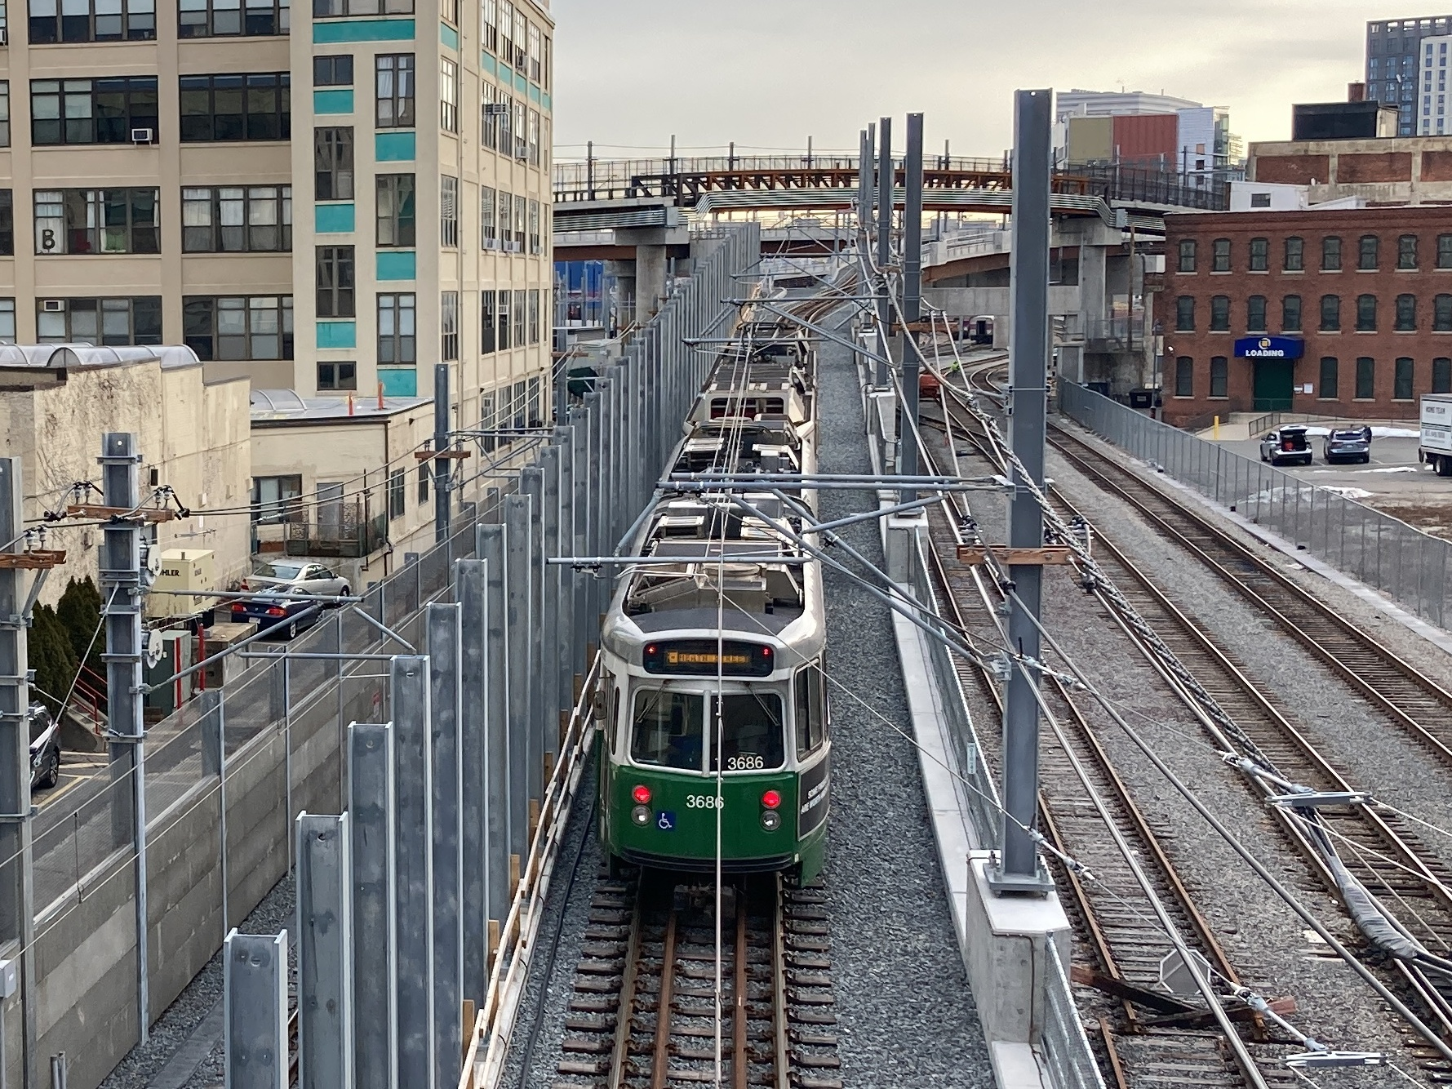
Tappan Street

Slide 6
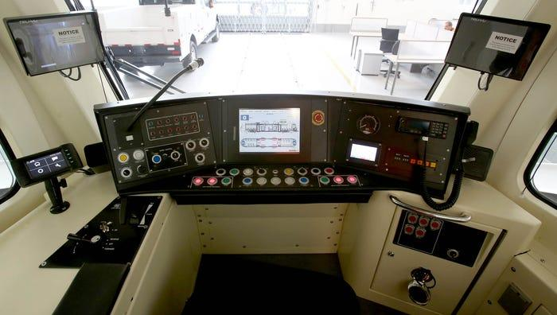
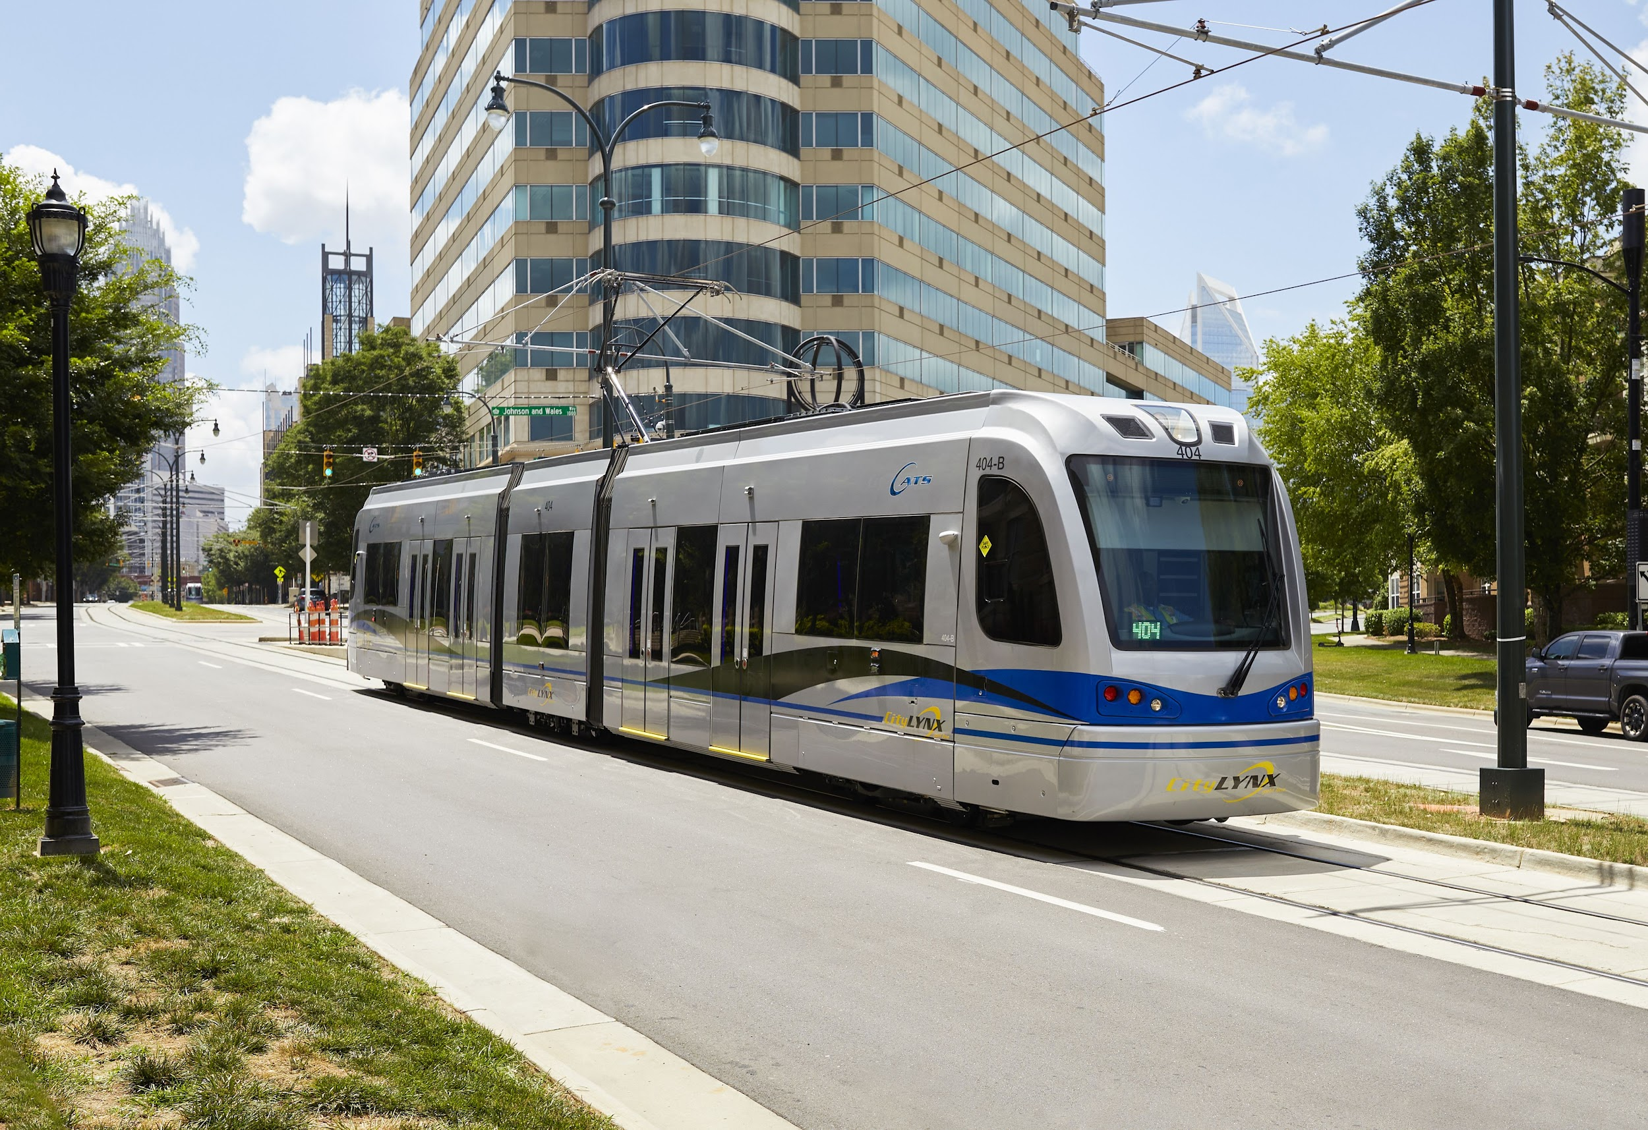
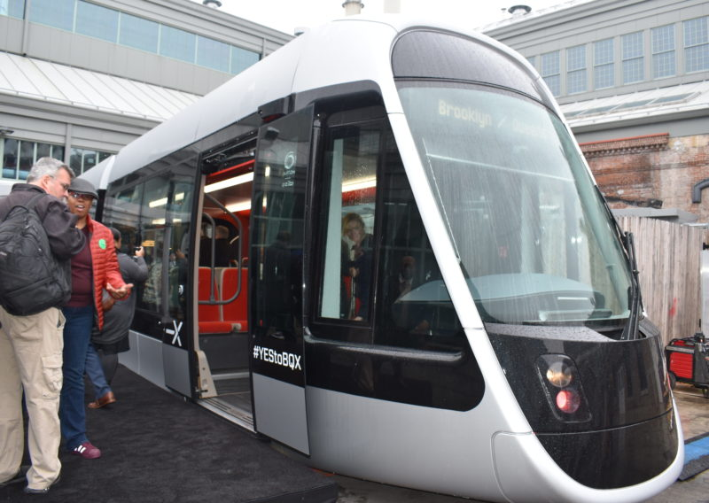
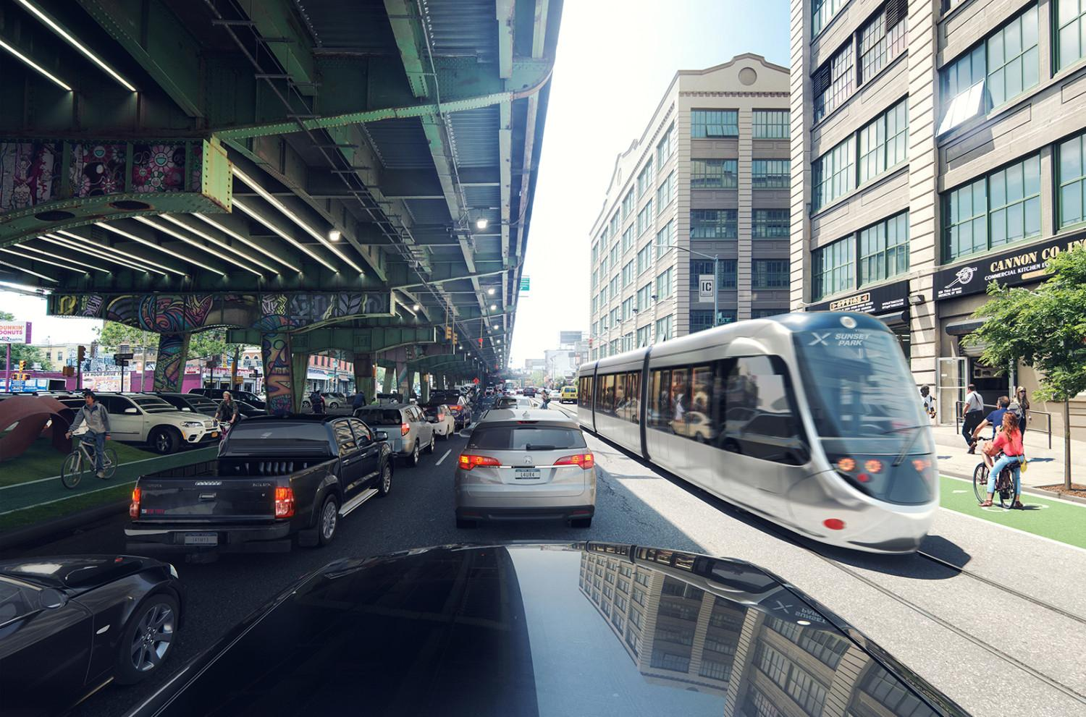
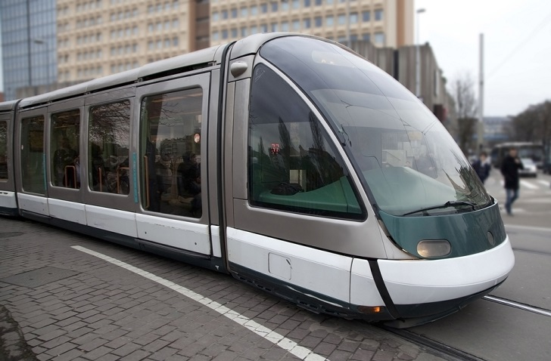
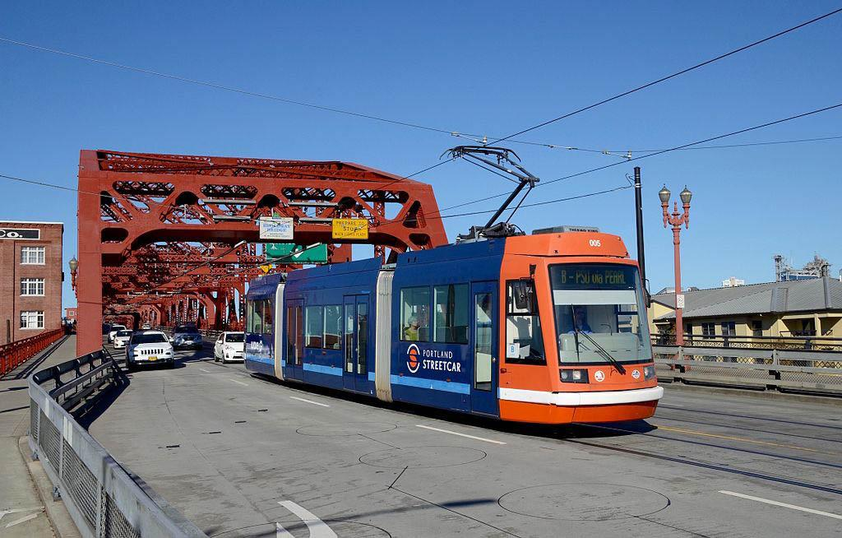
Streetcar

Slide 7
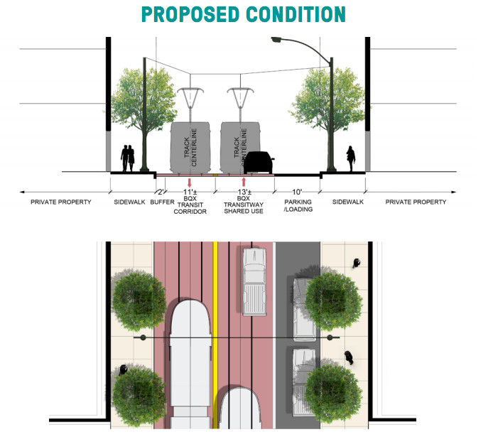
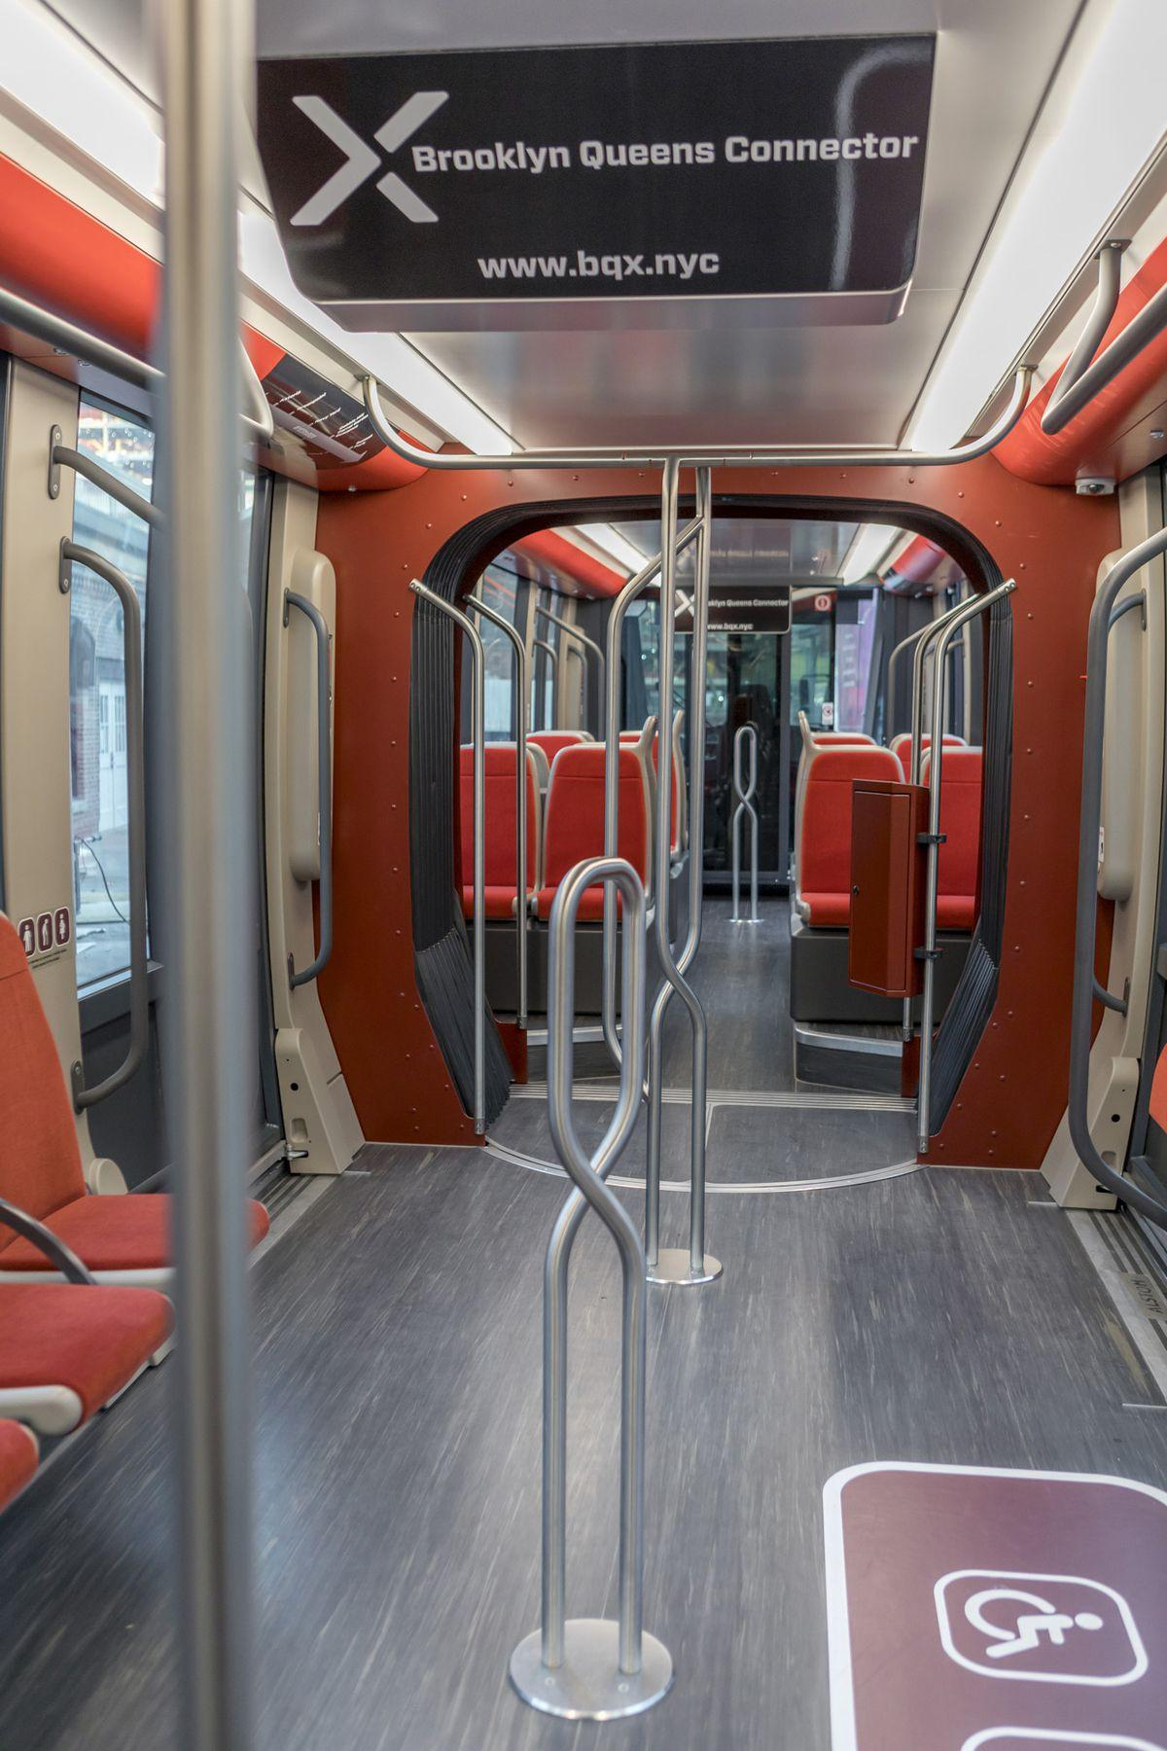
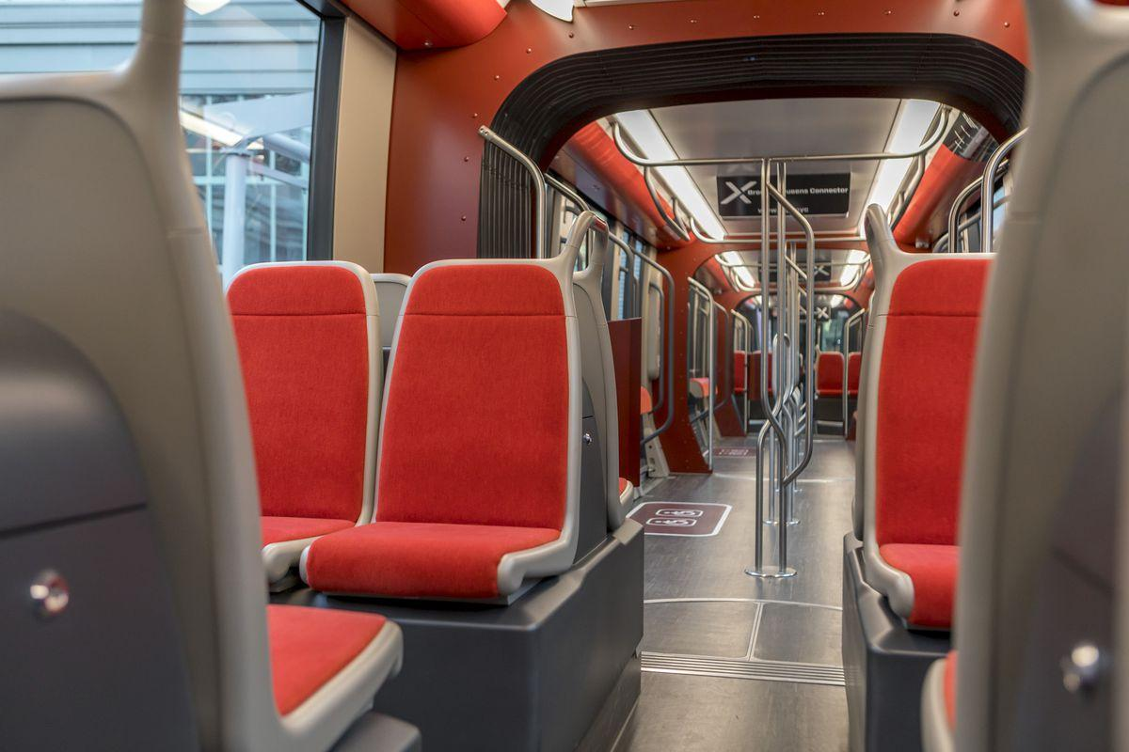
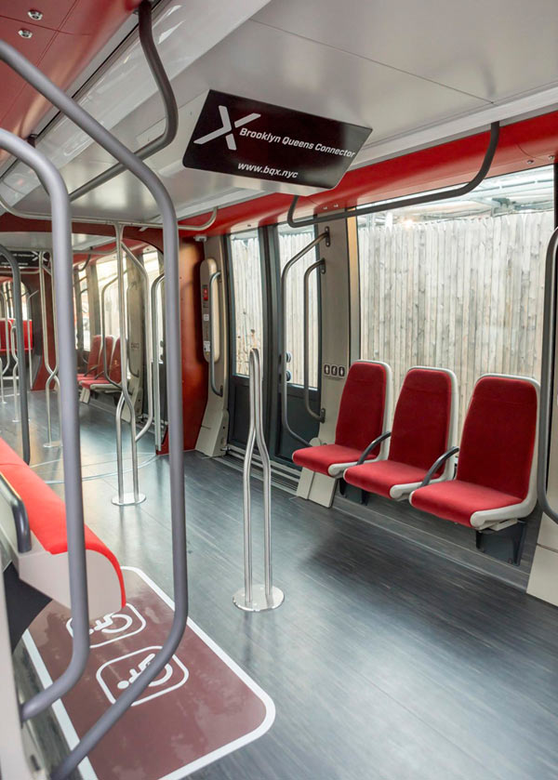
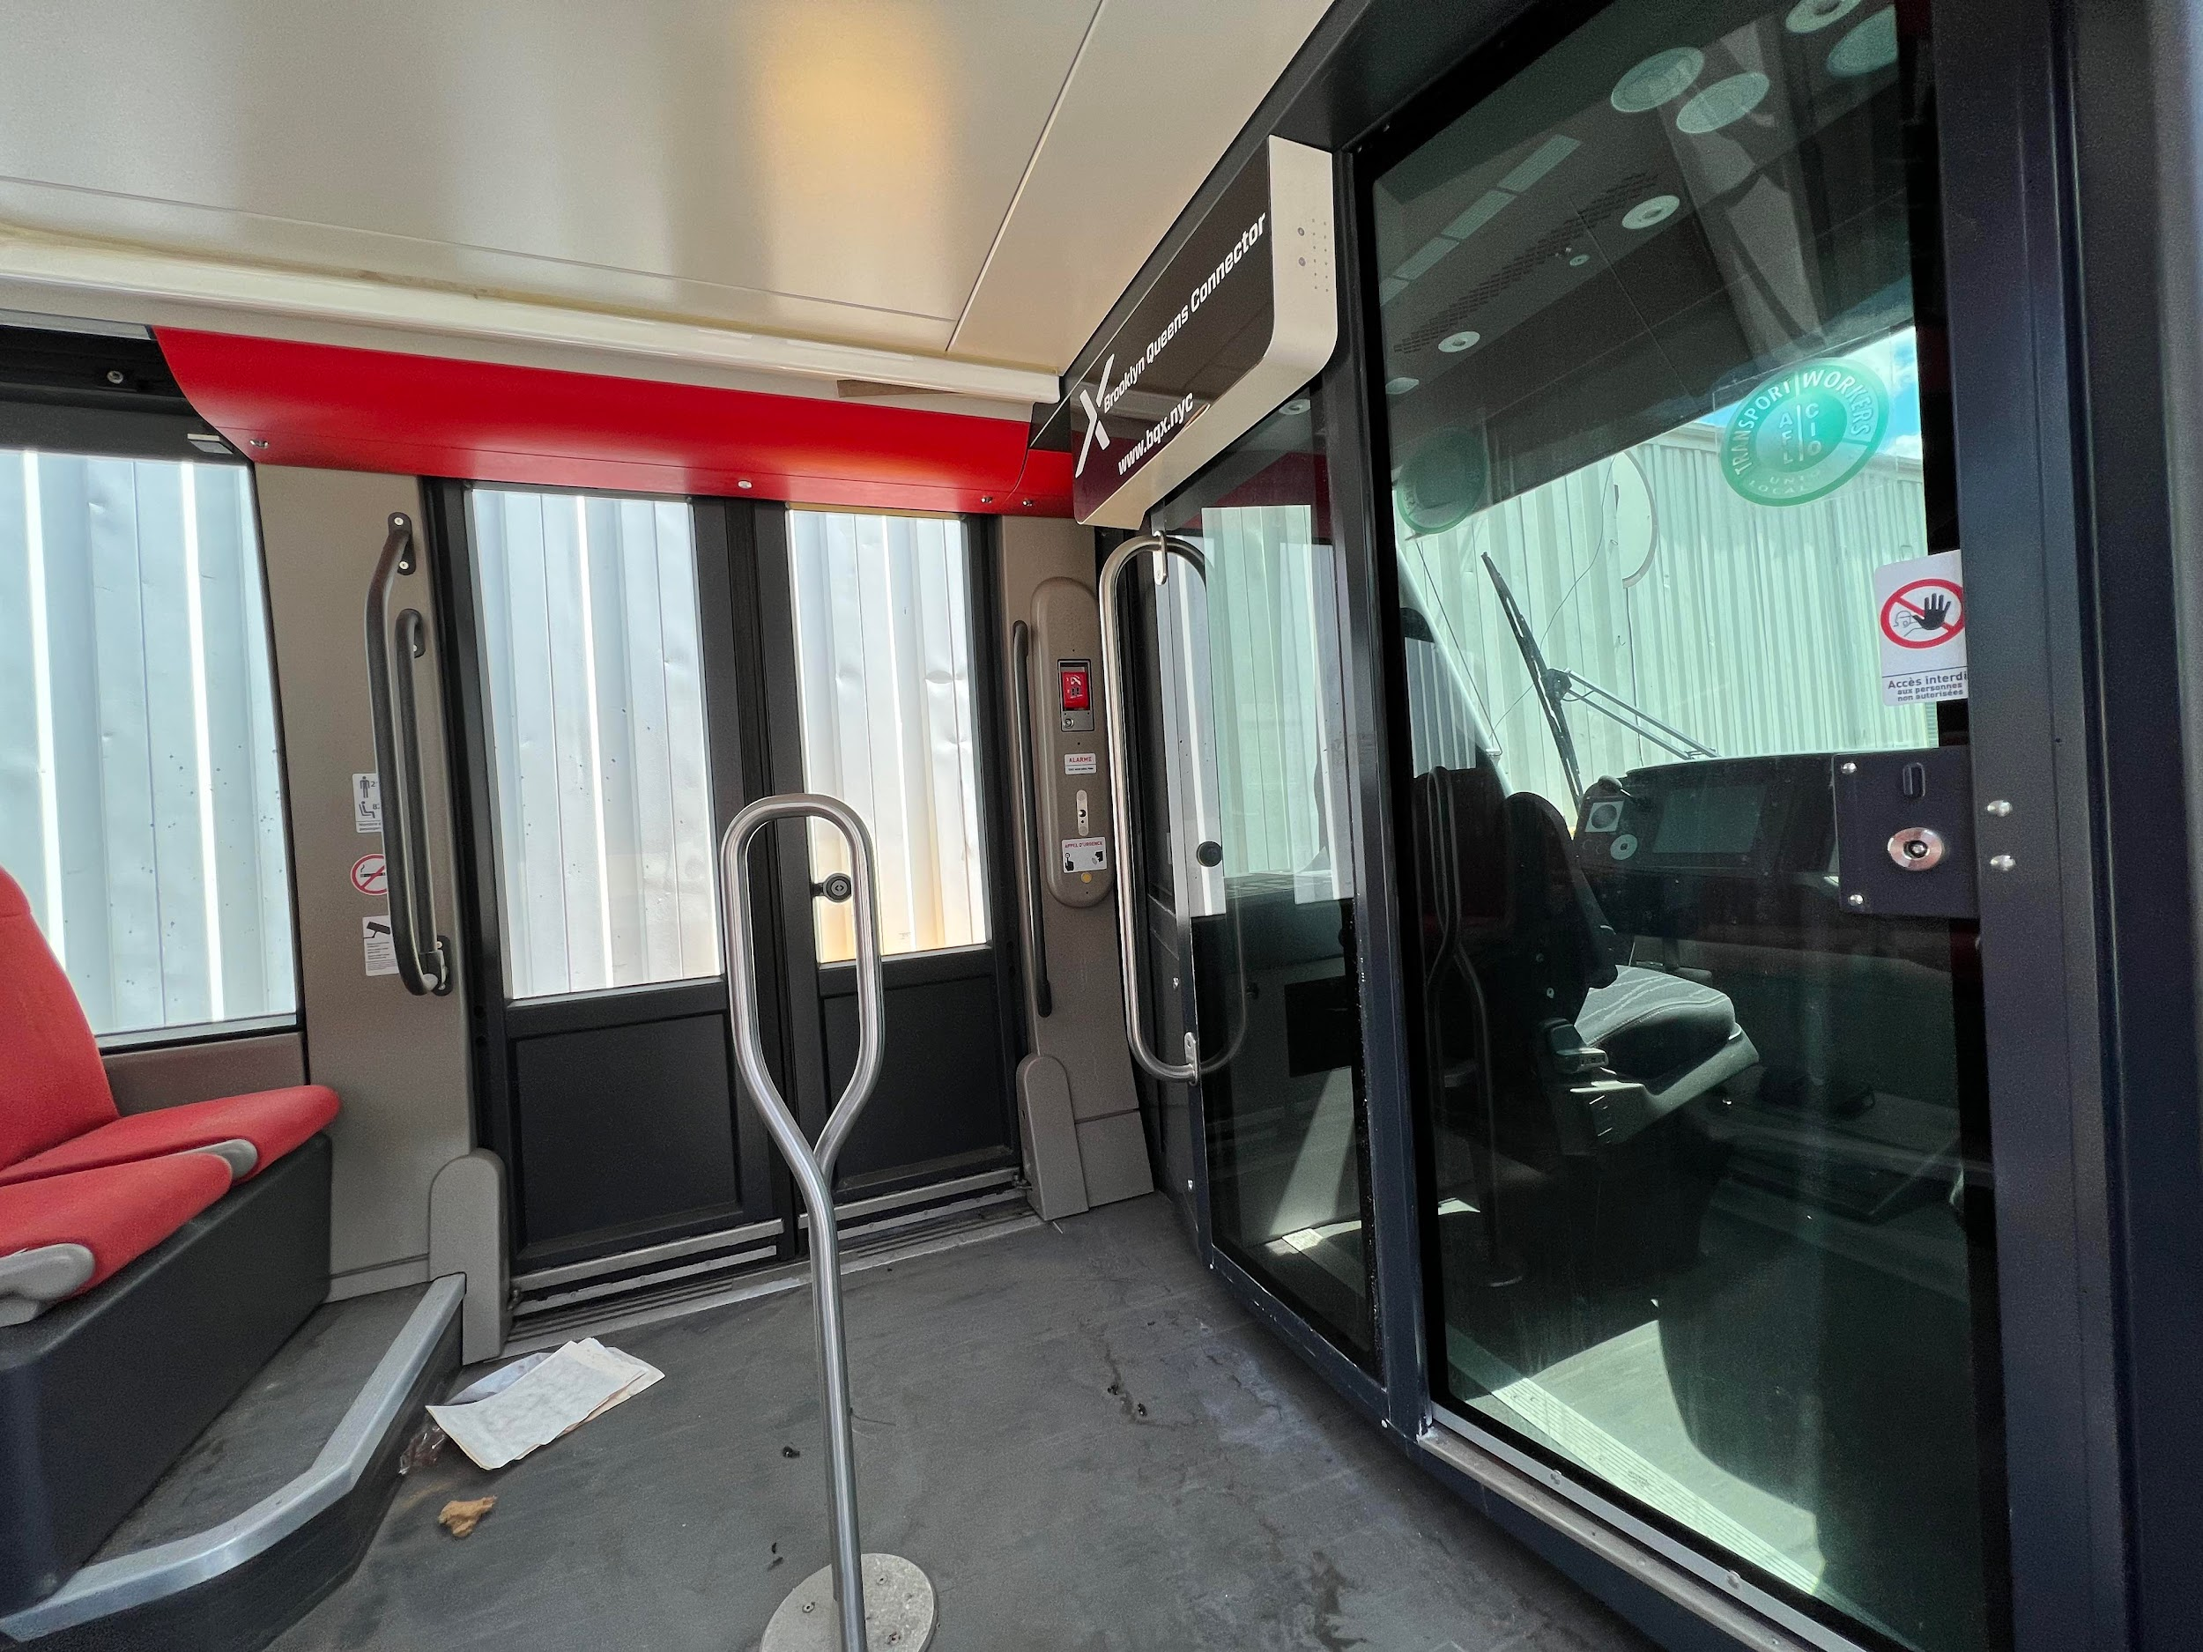
Streetcar

Slide 8
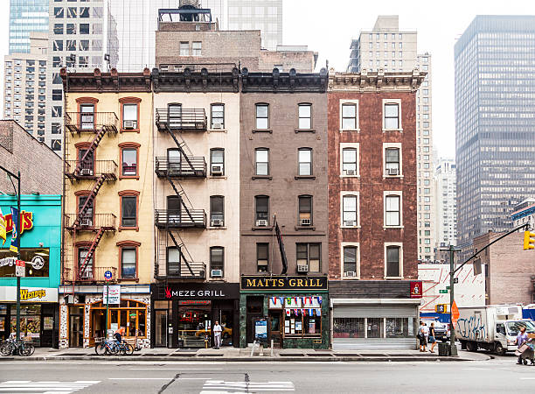
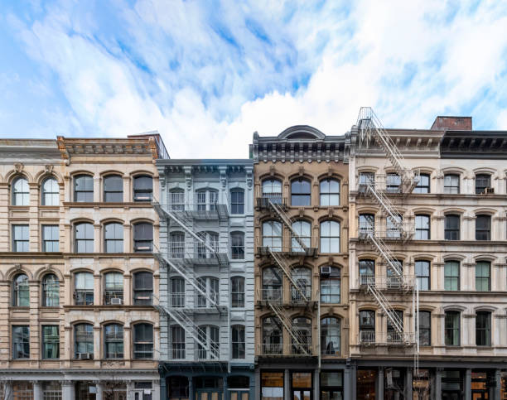
Buildings

Slide 9
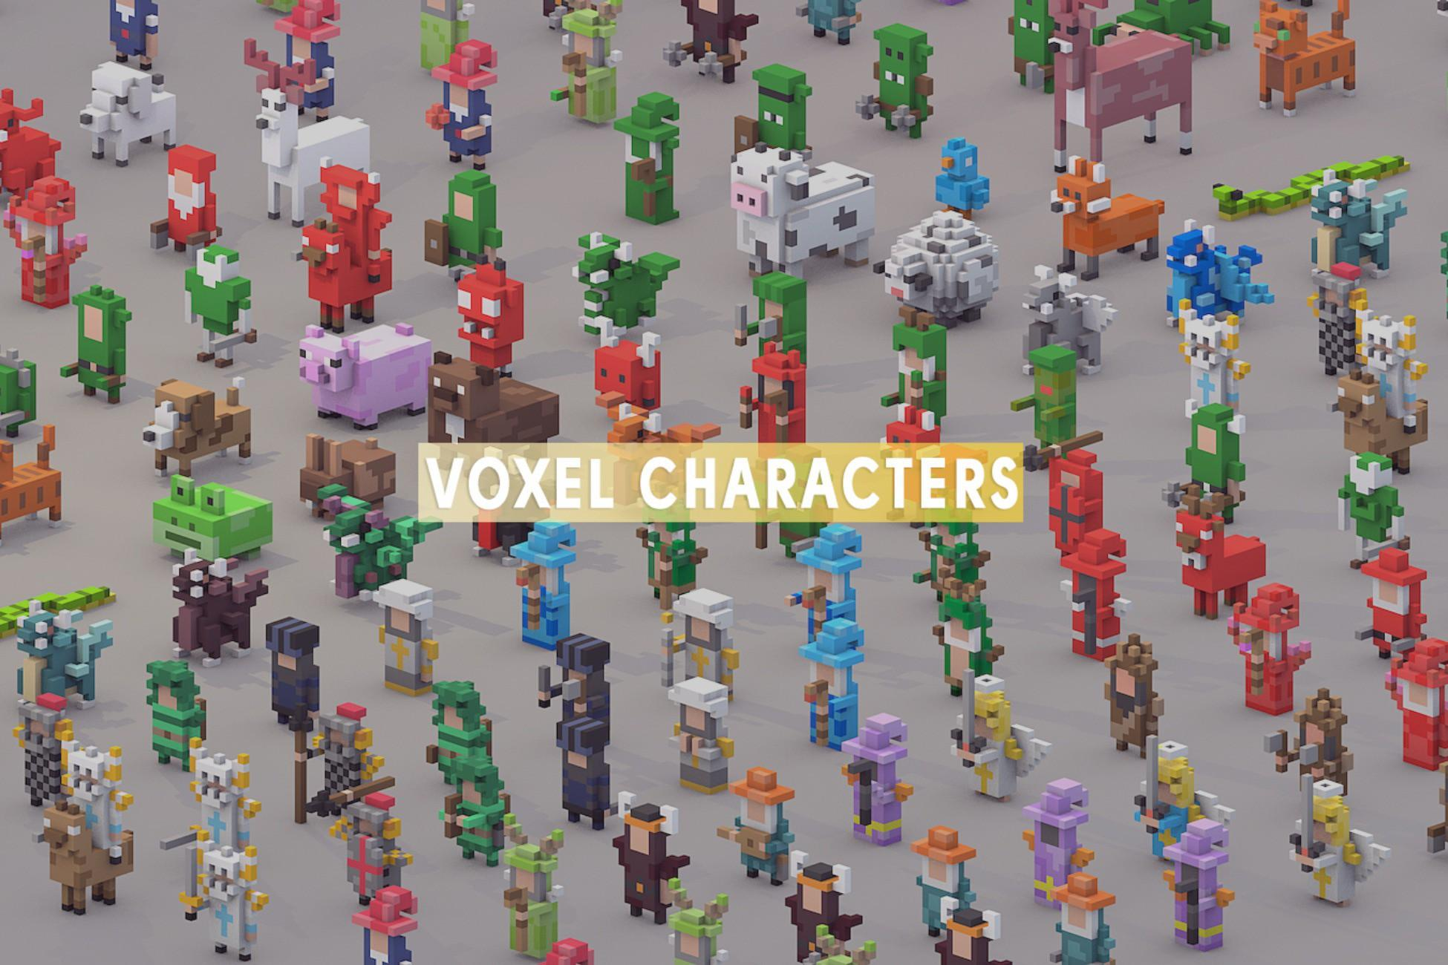
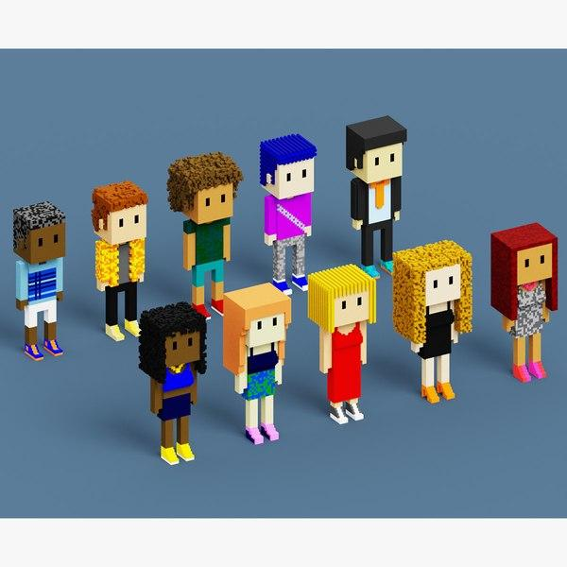
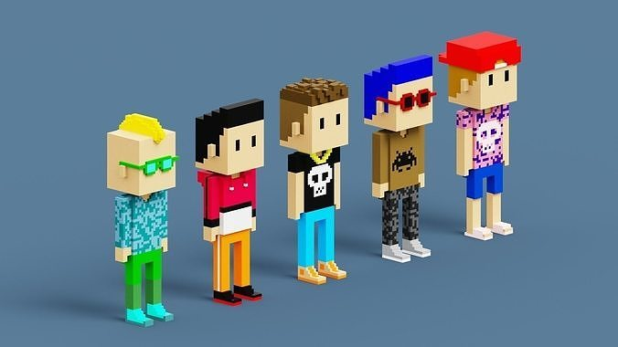
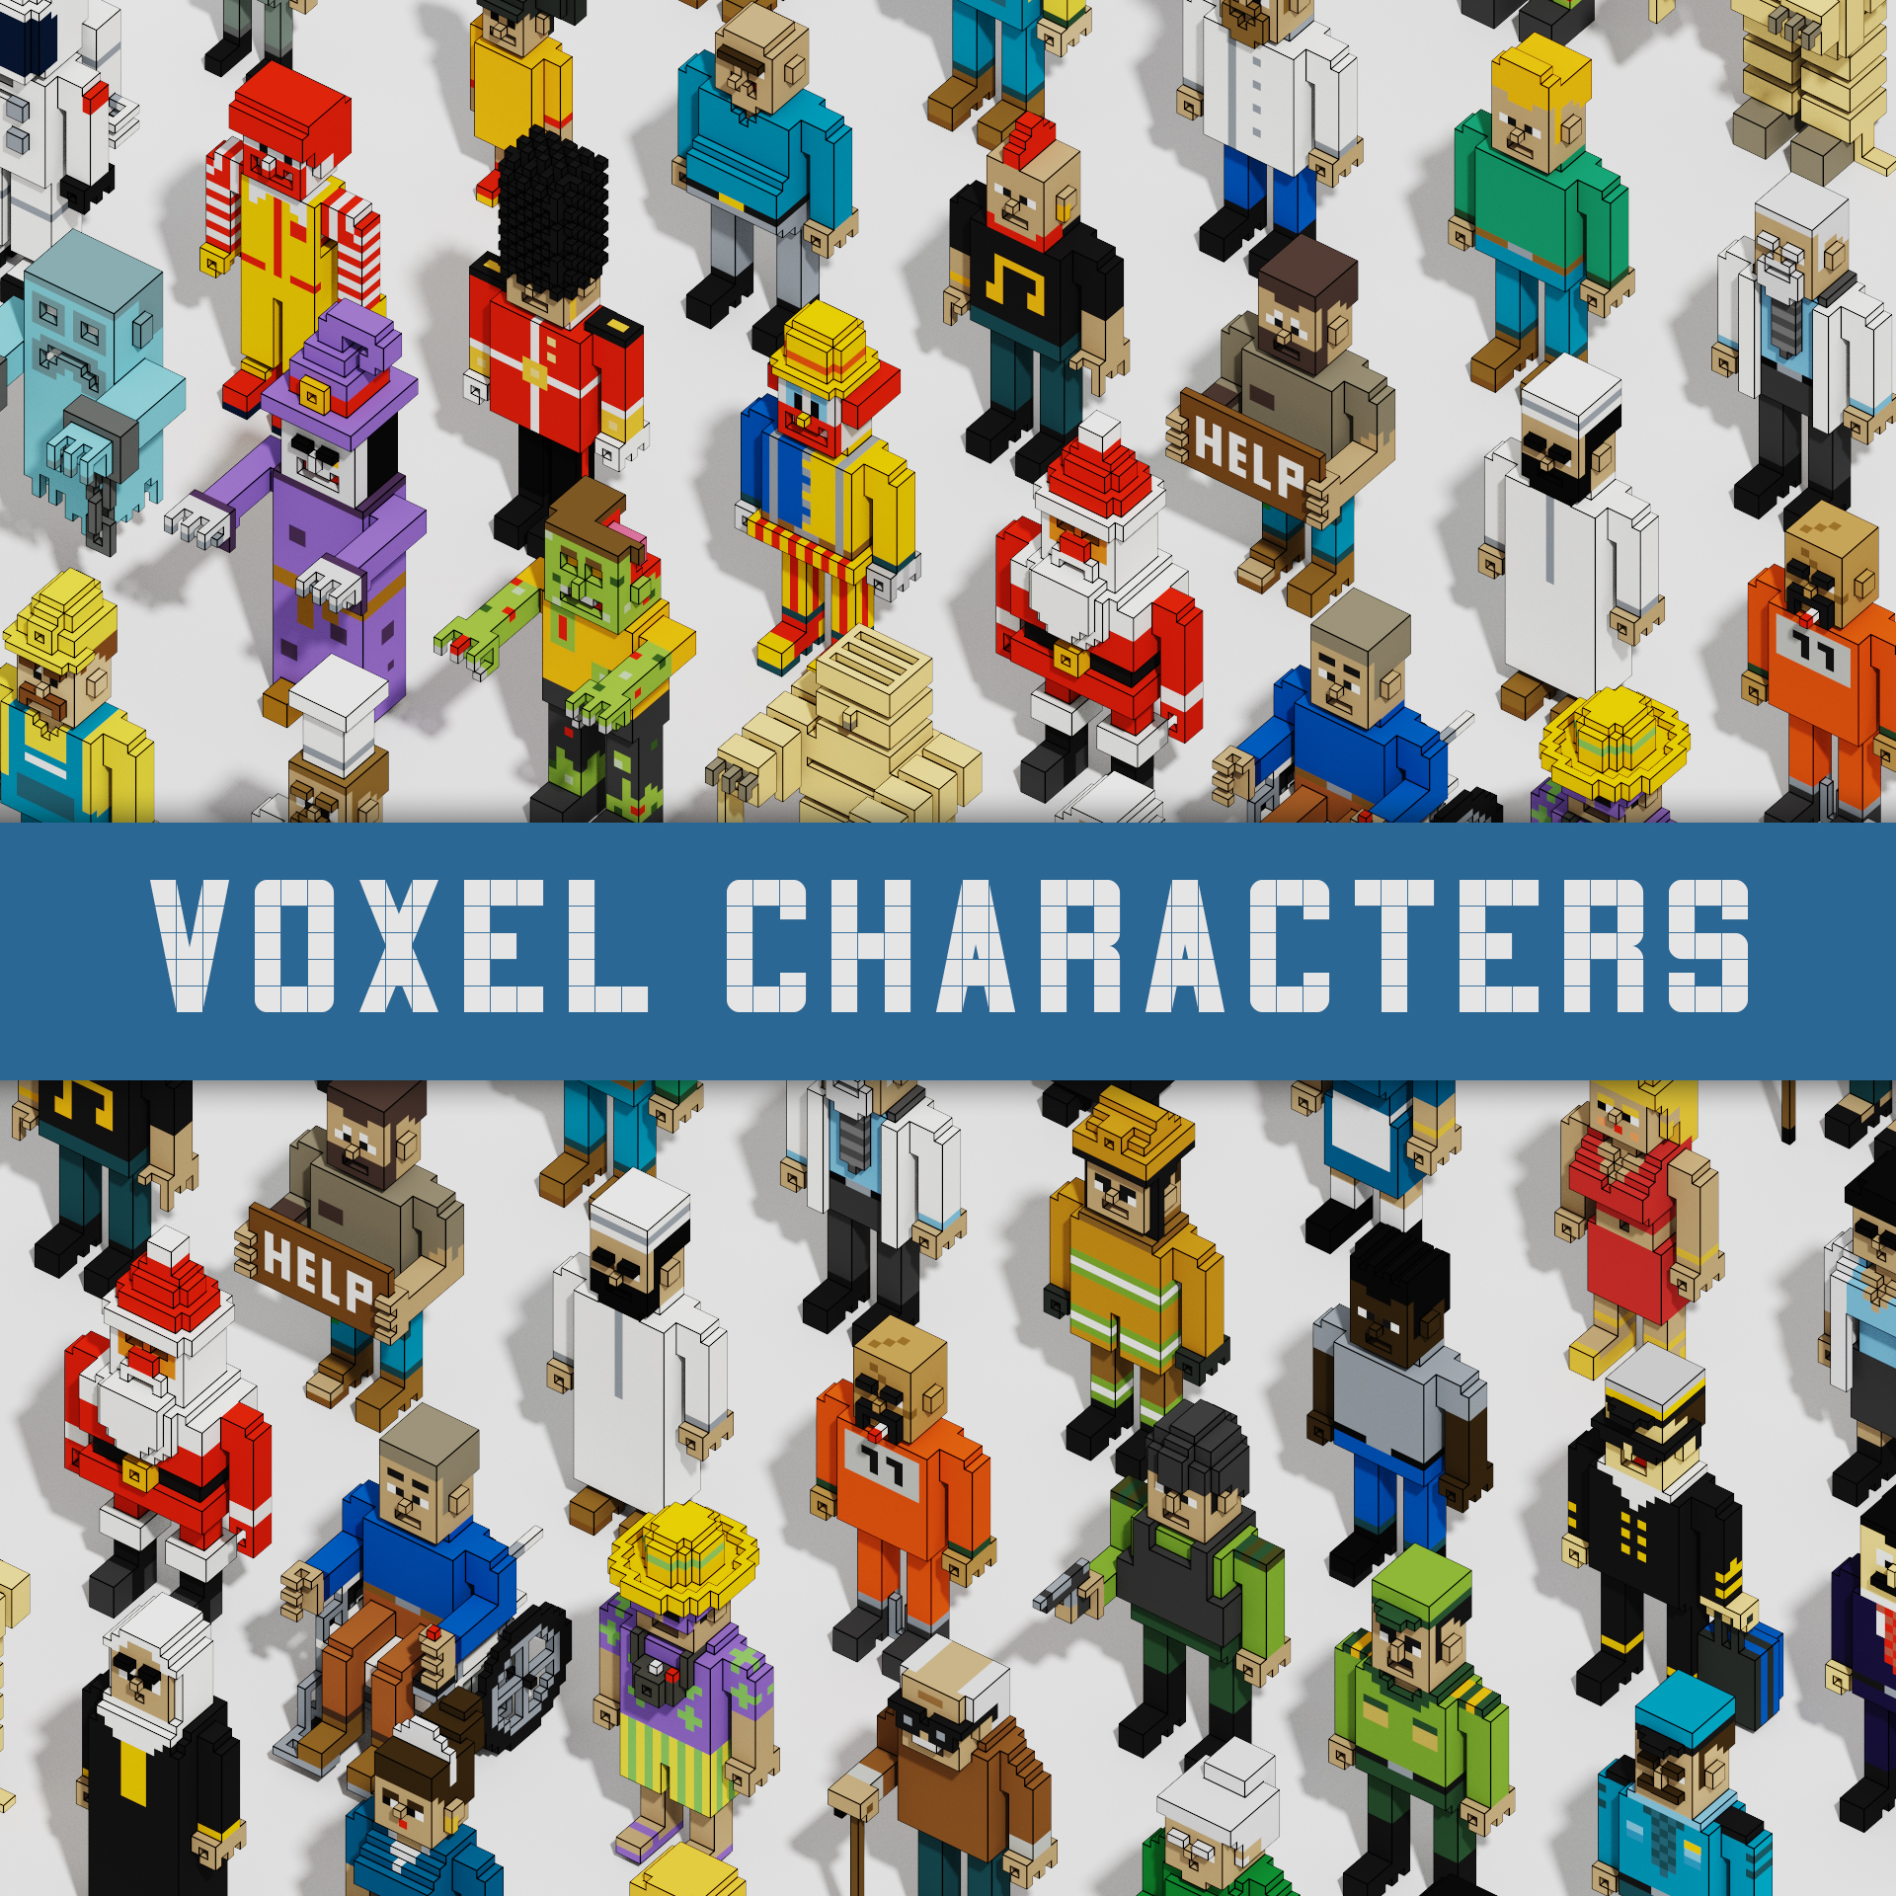
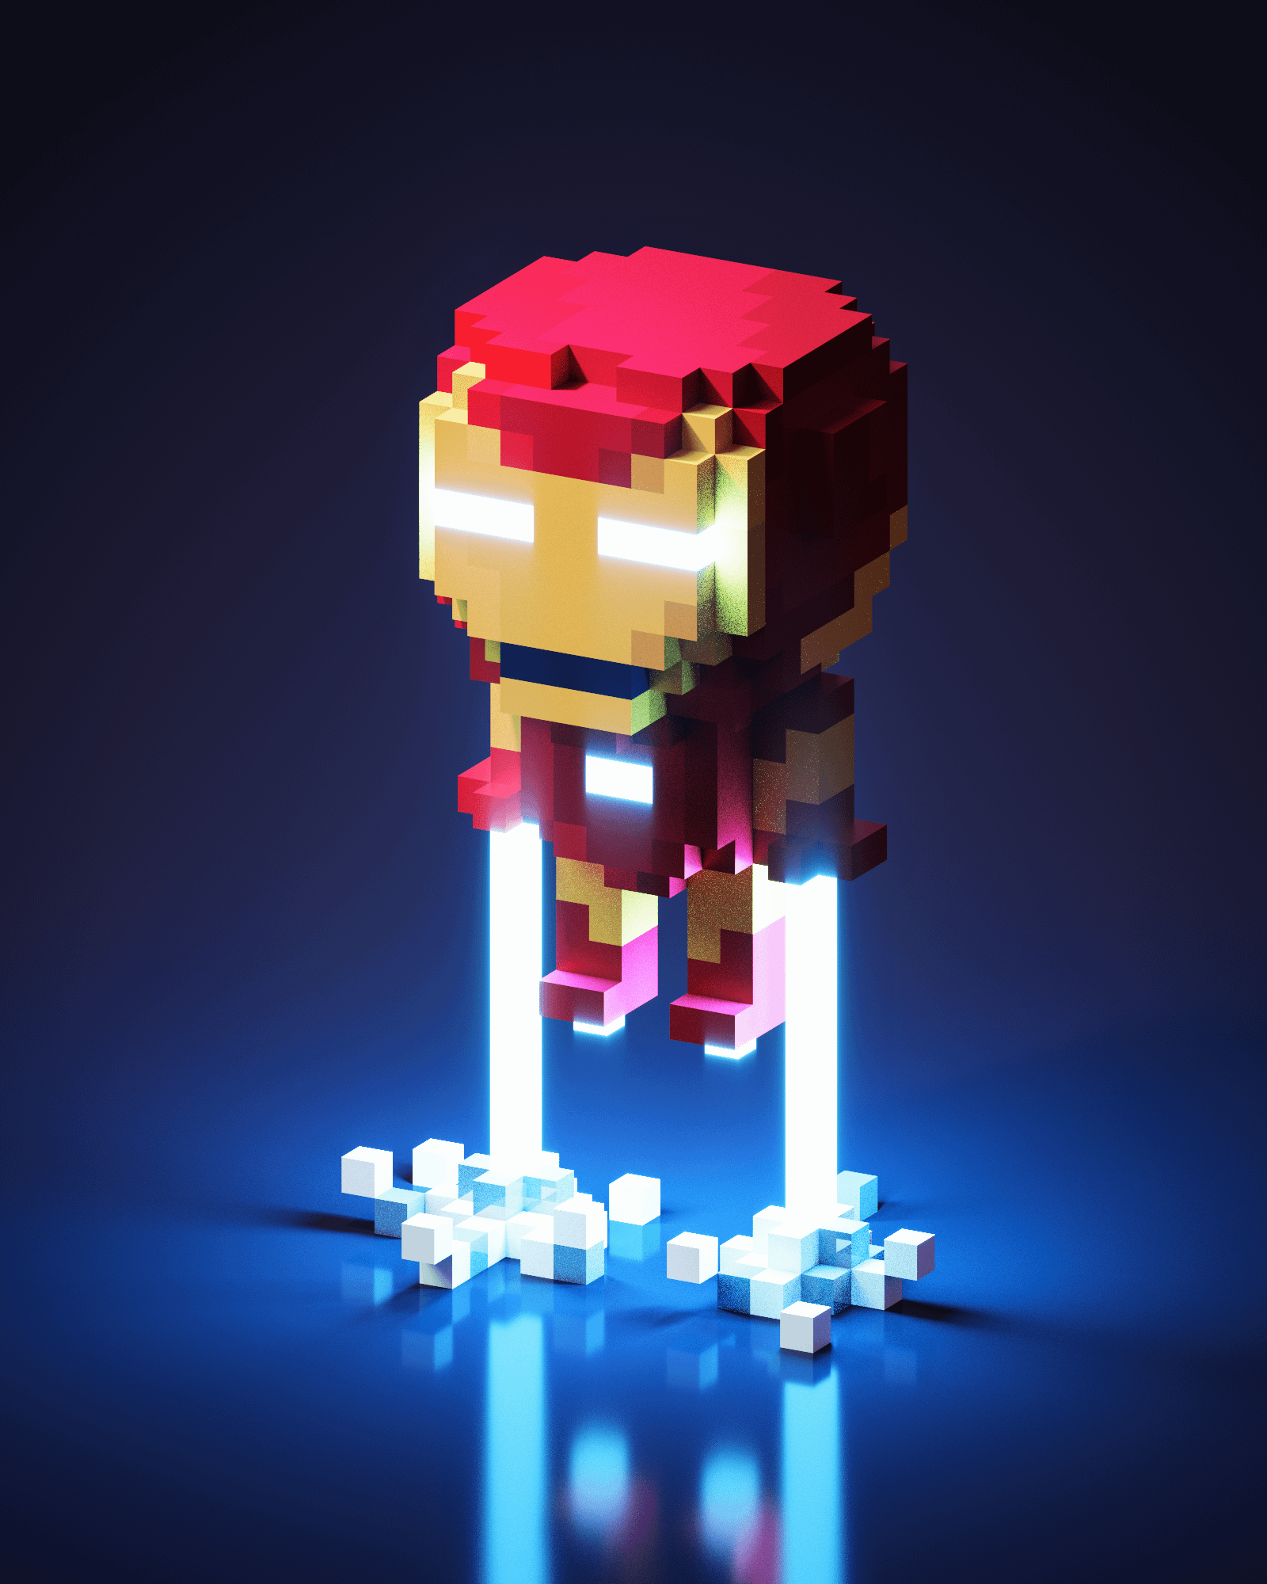
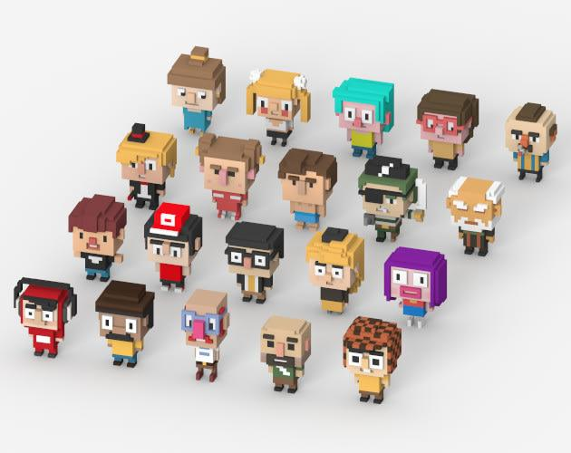
Style Voxel Art
Magic of Voxel: https://ephtracy.github.io/

Slide 10
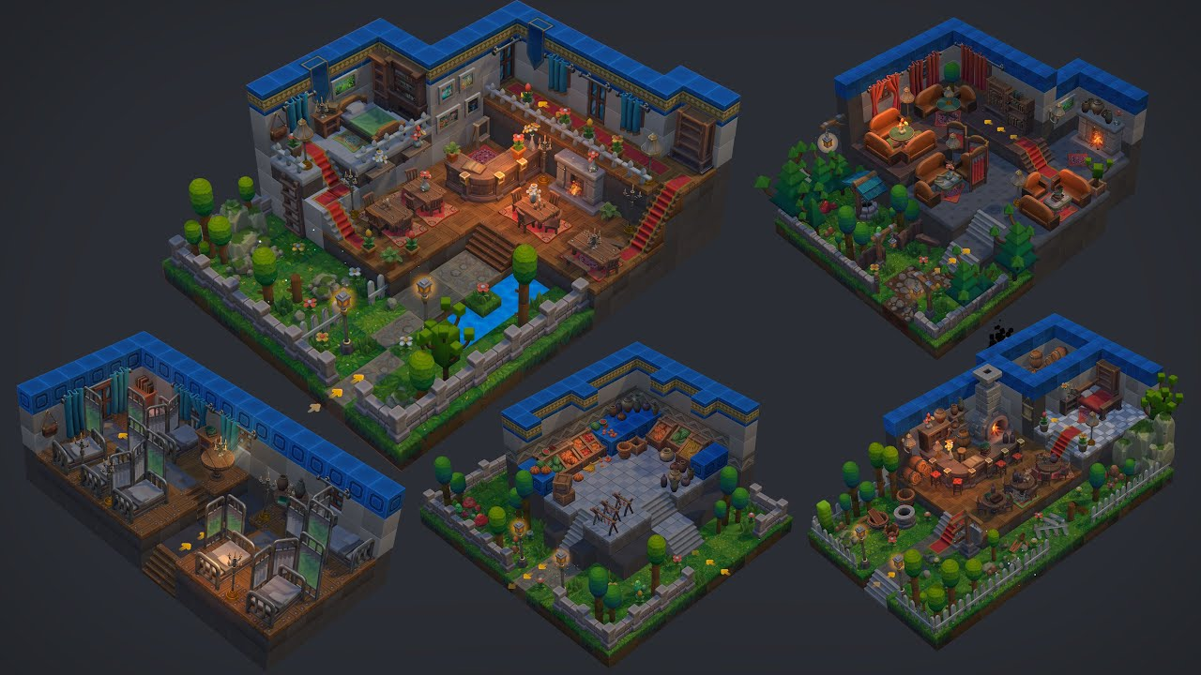
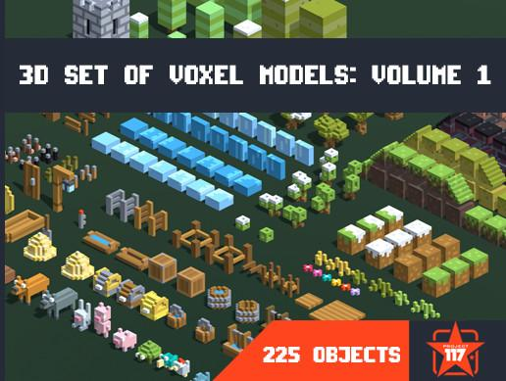
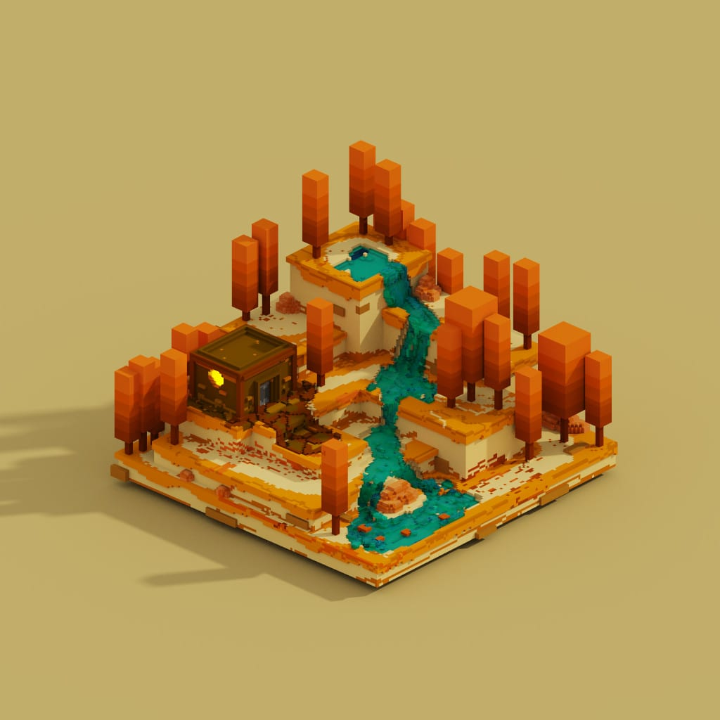

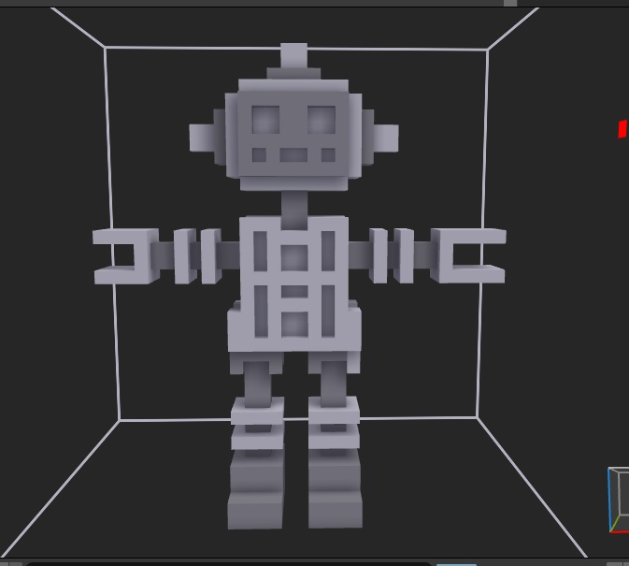
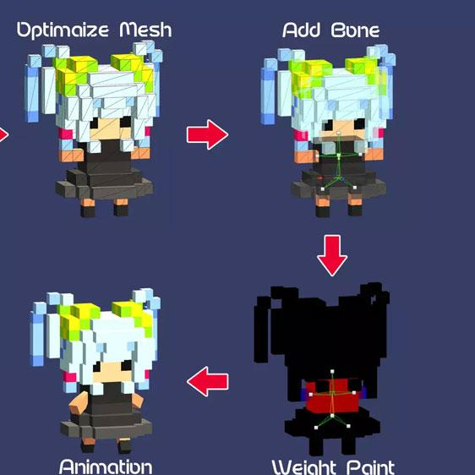
Style Voxel Art

